Slide 1
Professor & Lawyer
Puttu Guru Prasad
B.Com., M.Com., M.Phil., M.B.A., PGDFTM., AP.SET.,
M.Phil., DRMS., L.L.B., ICFAI TMF., DIRM., L.L.M.,
Pre PhD (PhD)from JNTUK.,
“Diploma in Psychology from YALE University”
MHRDI’s IIC Ambassador
NSS Certified Program Officer, (A.U)
Senior Faculty for Business Studies, Economics, Accounts
Head, Board of Administration & Management Science,
Bhagavad Gita & CLAT Program Coordinator,
Commerce Department, VIVA-VVIT, Nambur,
My Blog: puttuguru.blogspot.in
My Web Site: https://gurublogs.wixsite.com/guru
93 94 96 98 98, 9885 96 36 36, 807 444 9539,

Slide 2
Introduction to Managerial Economics
Professor & Lawyer.
Puttu Guru Prasad,
Senior Faculty for Management Studies, S&H Department, VVIT, Nambur, B.Com., M.Com., M.B.A., L.L.B., L.L.M., M.Phil., PGDFTM., AP.SET., ICFAI TMF., (PhD) at JNTUK., puttuguru.blogspot.in 93 94 96 98 98, 9885 96 36 36, 807 444 95 39 puttuvvit@gmail.com

Slide 3




Professor & Lawyer
Puttu Guru Prasad

Slide 4
EEM – Unit-1- Syllabus
UNIT-I: Introduction to Managerial Economics and demand Analysis:
Definition of Managerial Economics –Scope of Managerial Economics and its relationship with other subjects –
Concept of Demand, Types of Demand, Determinants of Demand schedule, Demand curve, Law of Demand and its limitations-
Elasticity of Demand, Types of Elasticity of Demand and Measurement- Demand forecasting and Methods of forecasting,
Concept of Supply and Law of Supply.

Slide 5
Basis for Comparison | Ordinal Utility | Cardinal Utility
Meaning | The utility where user satisfaction of a commodity is evaluated by preference but cannot be written in numbers. | The utility where user satisfaction is derived by a consumer from its consumption and can be expressed in numerical units.
Approach | Qualitative | Quantitative
Evaluation | Ranks | Utils
Examination | Indifference Curve Analysis | Marginal Utility Analysis
Promoted by | Modern economists | Traditional and neo-classical economists
Realistic | More | Less
Here Is a Comparison Chart That Shows Ordinal vs Cardinal utility.
Cardinal utility is a function that determines the satisfaction of a commodity used by an individual and can be supported with a numeric value. On the other hand, ordinal utility defines that satisfaction of user goods can be ranked in order of preference but cannot be evaluated numerically. In 1934 John Hicks and Roy Allen produced the first paper which declared ordinal utility.

Slide 6
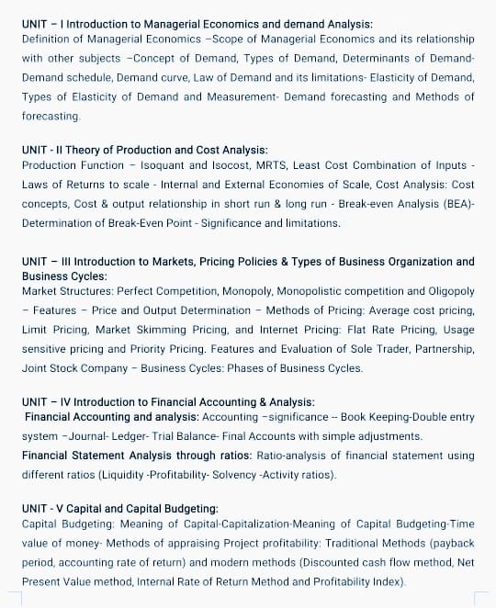

Slide 7

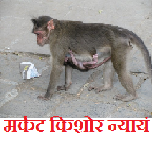

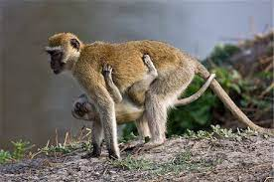

Slide 8

But the Best Student is Just like a Turtle
చిత్రం వటతరోర్మూలే వృద్ధాః శిష్యా గురుర్యువా |
గురోస్తు మౌనం వ్యాఖ్యానం శిష్యాస్తుచ్ఛిన్నసంశయాః ||
కూర్మ కిశోర న్యాయం
The mother turtle (Teacher) is from a bank on the river. Its calf (Student) is on the other side. It does not nurse or nurture him. Its sight alone gives it vitality. Little turtles remember their mother doing nothing. The mother tortoise acts as a stream of ambrosia for the little one. That is the basis of happiness in life. This is the relationship of teacher to disciple.

Slide 9

The Importance of Curves, Graphs, Tables and Diagrams in Economics
If you want to understand Managerial Economics properly, you have to study more than 100 Graphs effectively.

Slide 10
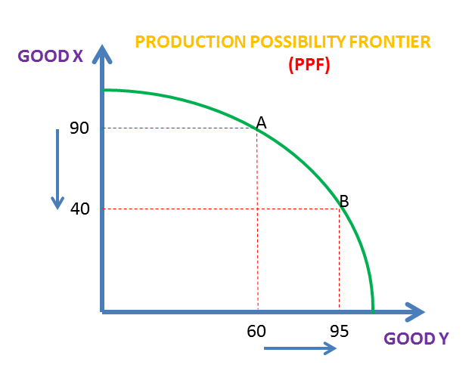
The First and Foremost Graph of Economics

Slide 11
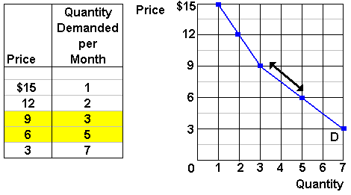

Slide 12
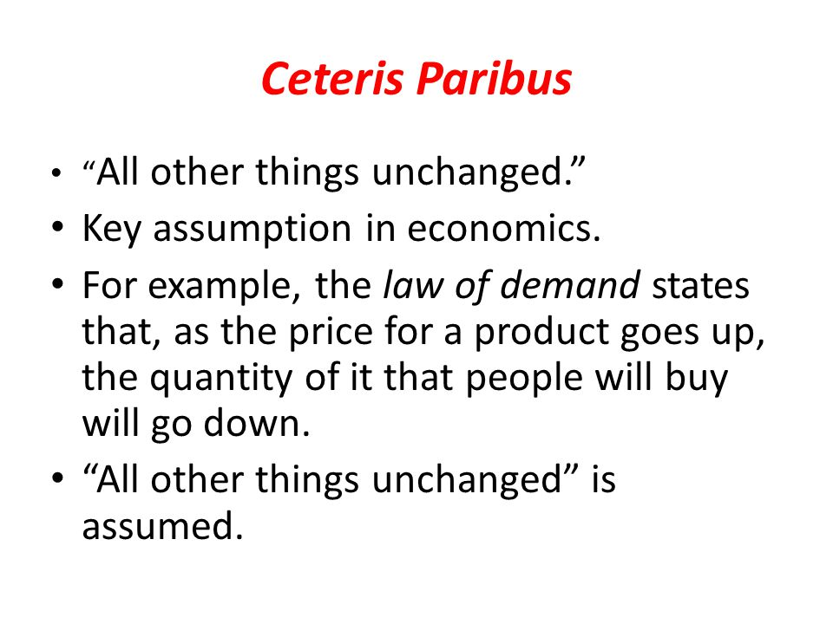


Slide 13
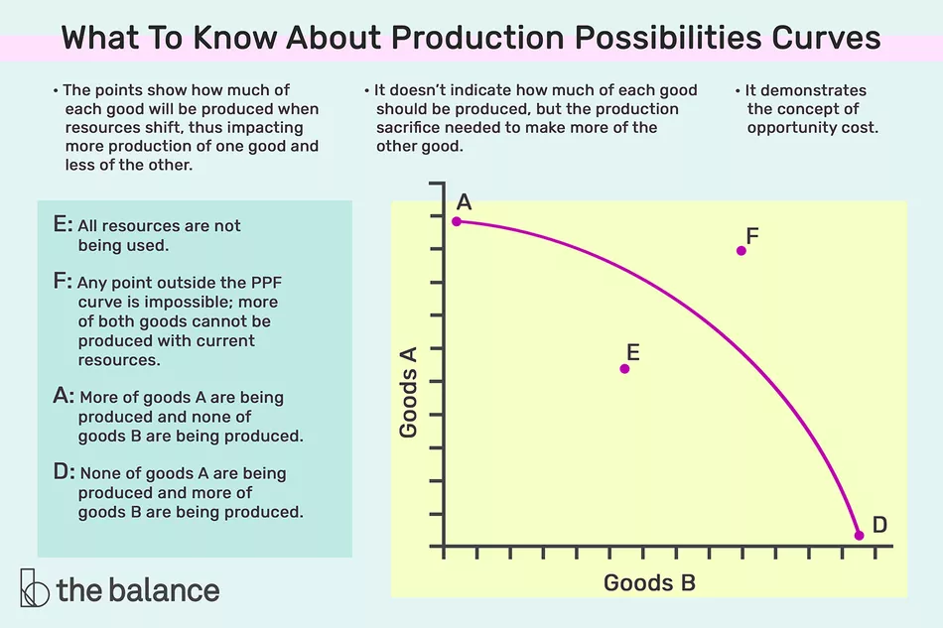

Slide 14
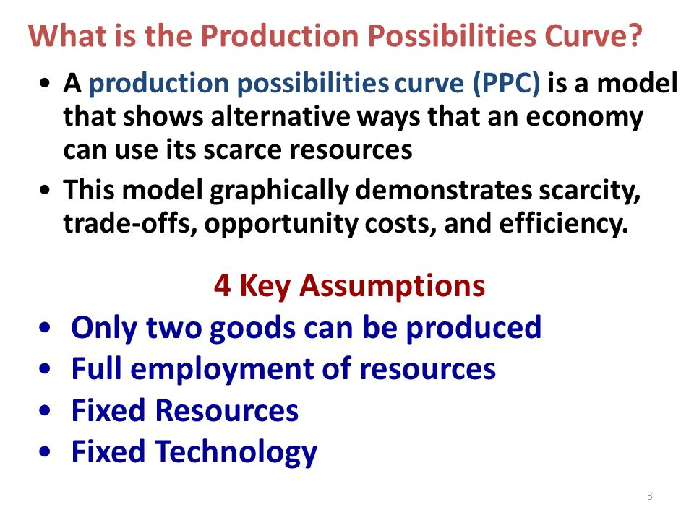

Slide 15
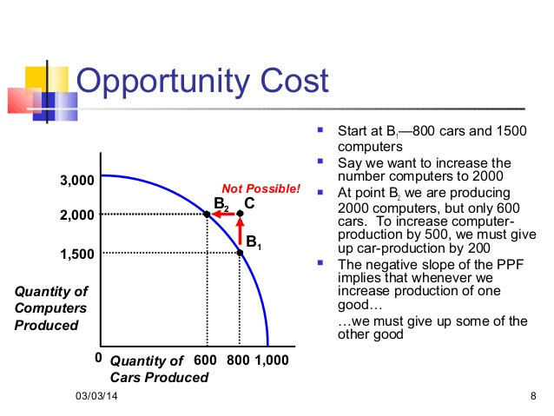

Slide 16
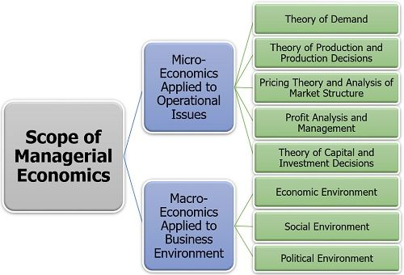

Slide 17
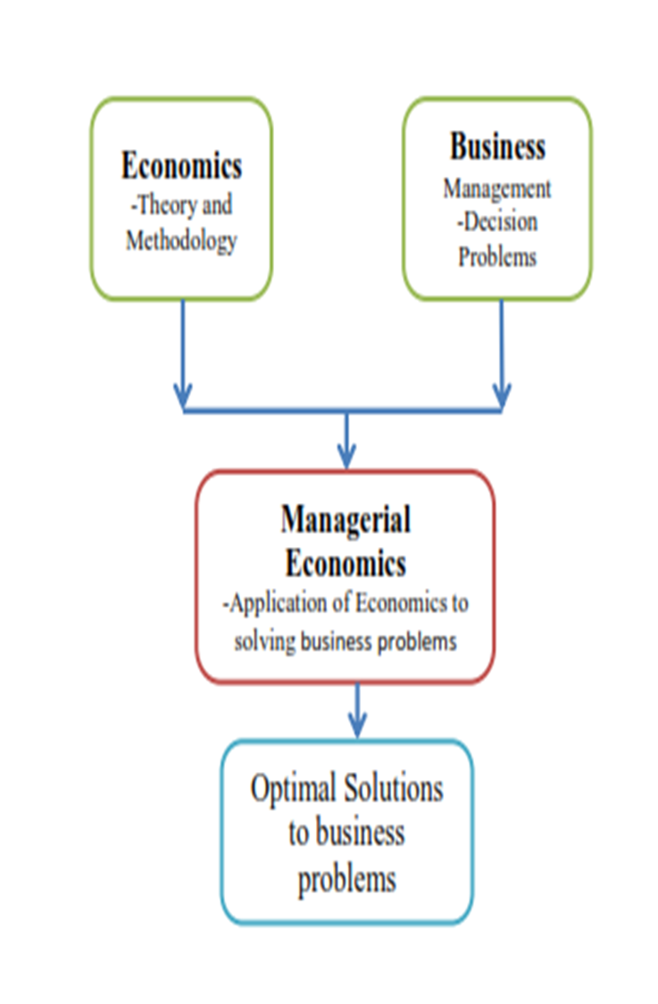
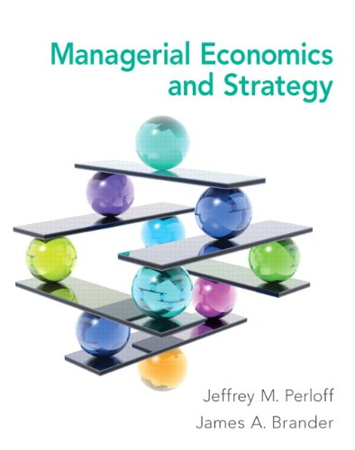

Slide 18
Economics is the social science
Economics is the
social science that studies how people
interact with value;
in particular,
the production,
the distribution,
and consumption of goods and services.
Economics focuses on the behavior and interactions of economic agents and how economies work.

Slide 19


The millennial behind the near $1 billion fashion startup Zilingo
27-year-old Ankiti Bose is the co-founder and CEO of Zilingo, an e-commerce fashion platform valued at nearly $1 billion. An Unicorn Company

Slide 20




CHATUCHAK WEEKEND MARKET BANGKOK

Slide 21



Moglix is India's leading online store for industrial tools and equipment

Slide 22
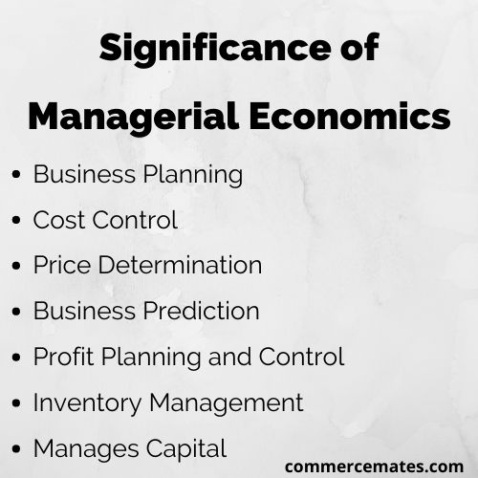

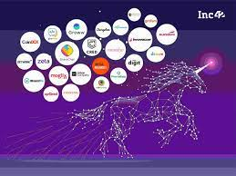
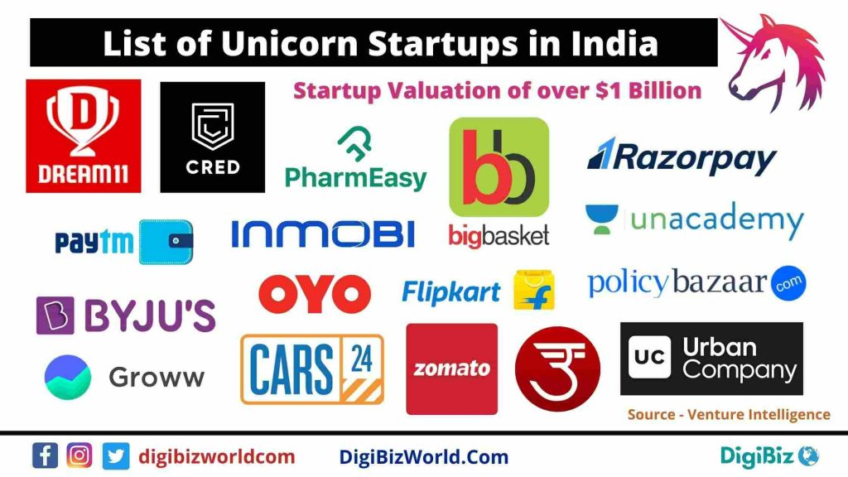

Slide 23




Slide 24
Managerial economics refers to the management of business using economic theories, tools, and concepts.
It is simply the amalgamation of management principles and economic theories for better problem solving and decision making.
It is a branch of economics that applies economic theories for analysis, assumption, and prediction of business conditions.
Managerial economics performs three important roles for business organizations: Demand analysis and forecasting, capital management and profit management.
Firms with the application of managerial economics optimally decide what to produce, how to produce and for whom to produce.

Slide 25
Concept of Economics
Economics is the science of choice in the face of unlimited ends and scarce means which have alternative uses. Since resources are scarce and the uses to which they can be put to are unlimited, one is required to choose the best amongst the available alternatives.
The crux of the problem which economics tries to address is the choice of the best uses of resources among the alternative uses.

Slide 26
Science of wealth
Economics is a study of human activity both at individual and national level. The economists of early age treated economics merely as the science of wealth. The reason for this is clear.
Every one of us is involved in efforts aimed at earning money and spending this money to satisfy our wants such as food, Clothing, shelter, and others.
Such activities of earning and spending money are called “Economic activities”.

Slide 27
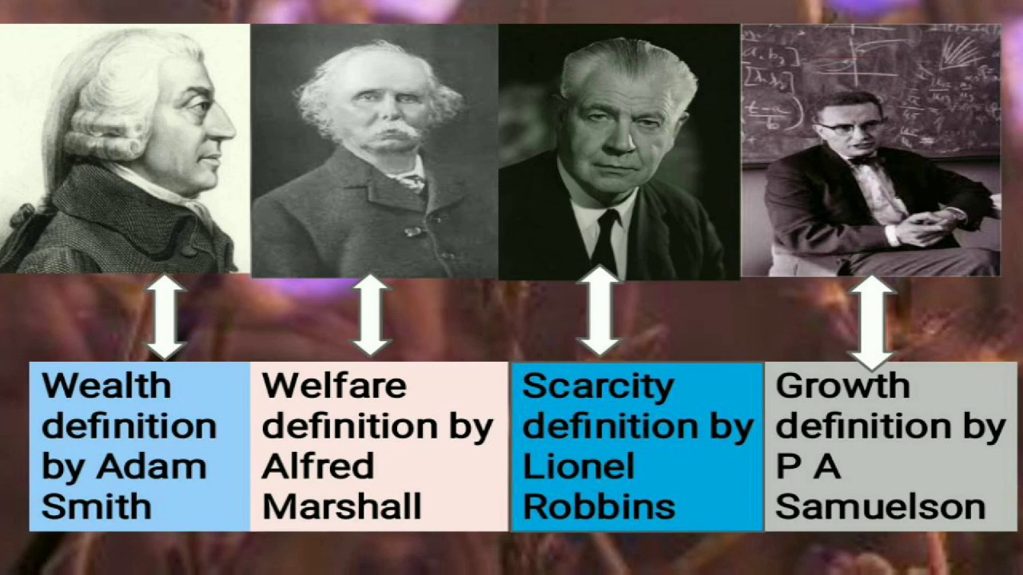

Slide 28
Adam Smith Wealth Definition
It was only during the eighteenth century that Adam Smith, the Father of Economics, defined economics as the study of nature and uses of national wealth’.
Smith defined economics as “an inquiry into the nature and causes of the wealth of nations.”

Slide 29

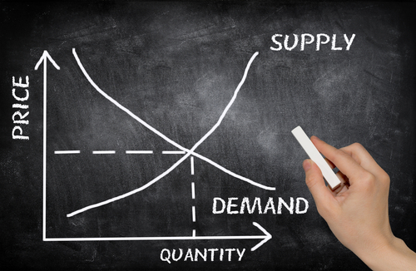
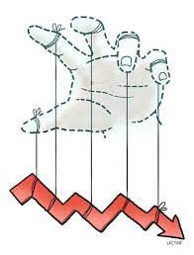
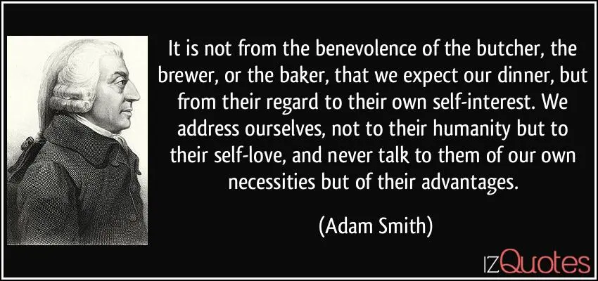

Slide 30
Dr. Alfred Marshall Welfare definition
Dr. Alfred Marshall, one of the greatest economists of the nineteenth century, writes “Economics is a study of man’s actions in the ordinary business of life: it enquires how he gets his income and how he uses it”.

Slide 31
Prof. Lionel Robbins Scarcity definition
Thus, it is one side, a study of wealth; and on the other, and more important side; it is the study of man.
As Marshall observed, the chief aim of economics is to promote ‘human welfare’, but not wealth.
Prof. Lionel Robbins defined Economics as “the science, which studies human behaviour as a relationship between ends and scarce means which have alternative uses”. With this, the focus of economics shifted from ‘wealth’ to human behaviour’.

Slide 32
Paul Samuelson Growth definition
Economics is the study of how men and society choose, with or without the use of money, to employ scarce productive resources which could have alternative uses, to produce various commodities over time and distribute them for consumption now and in the future amongst various people and groups of society”.

Slide 33
John Maynard Keynes The Economic Consequences of the Peace, Versailles treaty
Lord Keynes defined economics as ‘the study of the administration of scarce means and the determinants of employments and income”.
Pigou defines Economics as “the study of economic welfare that can be brought directly and indirectly, into relationship with the measuring rod of money”.

Slide 34
Managerial economics
The study of an individual consumer or a firm is called Micro-economics.
Managerial economics has its roots in microeconomics and it deals with the micro or individual enterprises.
It is concerned with the application of the concepts such as price theory, Law of Demand and theories of market structure and so on.
The study of ‘aggregate’ or total level of economics activity in a country is called Macro-economics.
It studies the flow of economic resources or factors of production (such as land, labour, capital, organisation and technology) from the resource owner to the business firms and then from the business firms to the households.

Slide 35
Business Economics
Managerial Economics as a subject gained popularity in USA after the publication of the book “Managerial Economics” by Joel Dean in 1951.
Managerial Economics refers to the firm’s decision making process. It could be also interpreted as “Economics of Management” or “Economics of Management”. Managerial Economics is also called as “Industrial Economics” or “Business Economics”.

Slide 36
Managerial Economics
Managerial Economics bridges the gap between traditional economics theory and real business practices in two ways.
First it provides a number of tools and techniques to enable the manager to become more competent to take decisions in real and practical situations.
Secondly it serves as an integrating course to show the interaction between various areas in which the firm operates.

Slide 37
M. H. Spencer and Louis Siegel man
M. H. Spencer and Louis Siegelman explain the “Managerial Economics is the integration of economic theory with business practice for the purpose of facilitating decision making and forward planning by management”.
Managerial Economics, therefore, focuses on those tools and techniques, which are useful in decision-making.

Slide 39
మార్జాల కిశోర న్యాయం
మర్కట కిశోర న్యాయం

Slide 40
But the Best Student is Just like a Turtle
చిత్రం వటతరోర్మూలే వృద్ధాః శిష్యా గురుర్యువా |
గురోస్తు మౌనం వ్యాఖ్యానం శిష్యాస్తుచ్ఛిన్నసంశయాః ||
कुर्मा किशोर न्याय
కూర్మ కిశోర న్యాయం
The mother turtle (Teacher) is from a bank on the river. Its calf (Student) is on the other side. It does not nurse or nurture him. Its sight alone gives it vitality. Little turtles remember their mother doing nothing. The mother tortoise acts as a stream of ambrosia for the little one. That is the basis of happiness in life. This is the relationship of teacher to disciple.

Slide 41
1. Scope of managerial Economics
Economics has two major branches Micro economics and Macro economics. Both micro and macro economics are applied to business analysis which can be used to analyze the business environment and to find solutions to practical business problems

Slide 42
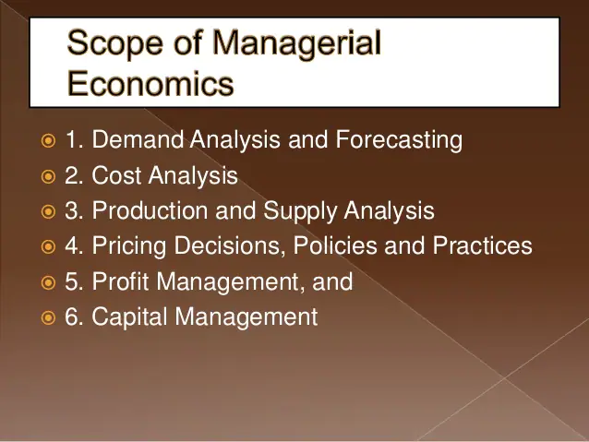

Slide 43
2. Need of managerial Economics
It is through management economics that a business understands how to access and utilize scarce resources to ensure optimal performance of the same to generate revenues and profits.

Slide 44
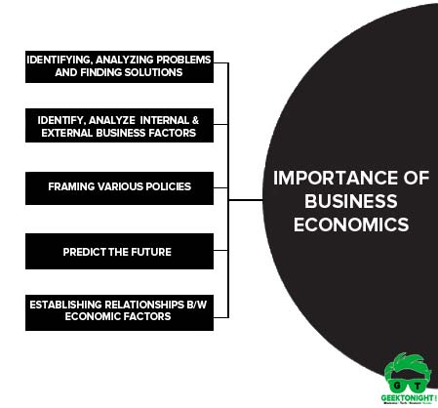

Slide 45
3.Nature of managerial Economics
Managerial economics is a science applied to decision making. It bridges the gap between abstract theory and managerial practice. It concentrates more on the method of reasoning. In short, managerial economics is “Economics applied in decision making”.

Slide 46
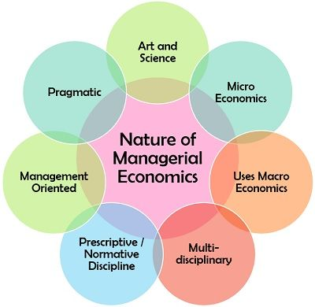

Slide 47
4. Objective of Managerial Economics
1. Integrating economic theory with business practice 2. Using economics tools to analyze business situations 3. Applying economic principles to solve business problems 4. Using economic ideas for crisis management 5. Facilitating demand analysis and demand forecasting 6. Allocating scarce resources for optimizing returns 7. Enabling risk taking and uncertainly bearing 8. Helping in profit maximization 9. Pursuing the larger objectives of the firm other than profit maximization 10. Formulating short-term and long-term business strategies

Slide 48
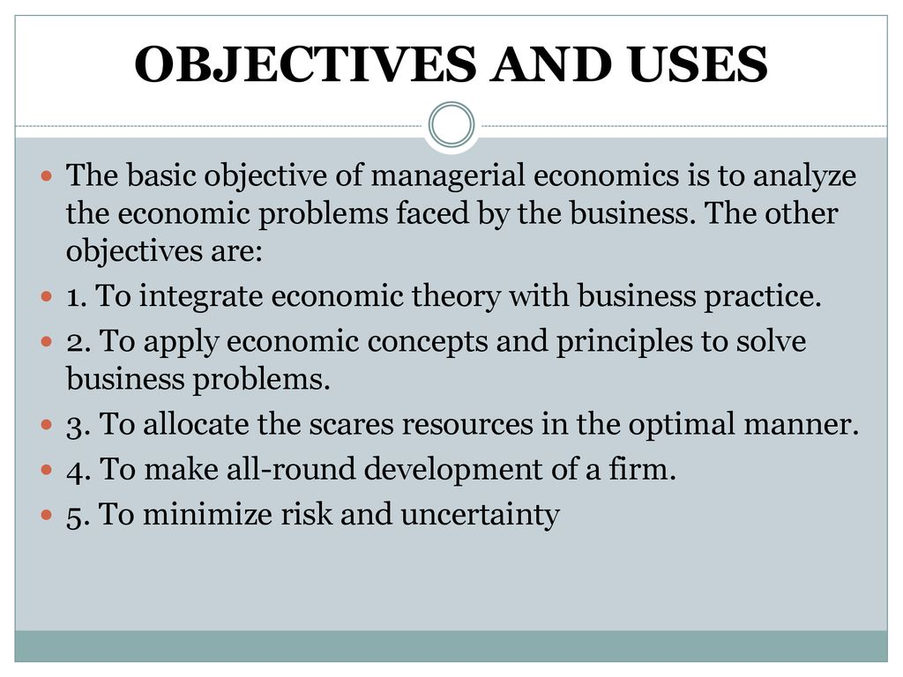

Slide 49
5. Purpose of Managerial Economics
The purpose of managerial economics is to provide economic terminology and reasoning for the improvement of managerial decisions. ... Microeconomics studies phenomena related to goods and services from the perspective of individual decision-making entities—that is, households and businesses.

Slide 50
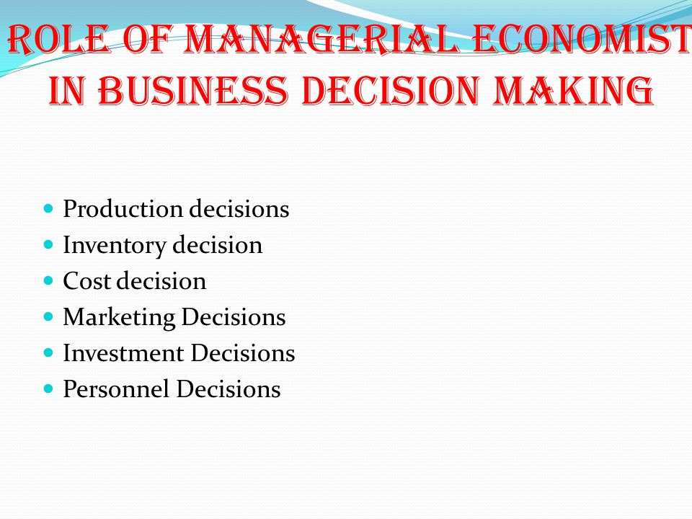

Slide 51
6. Significance of Managerial Economics
It is that branch of economics, which serves as a link between abstract theories and managerial practices. ... Thus Spencer and Seligman defined Managerial economics as “The integration of economic theory and business practice for the purpose of facilitating decision-making and forward planning by management.”

Slide 52
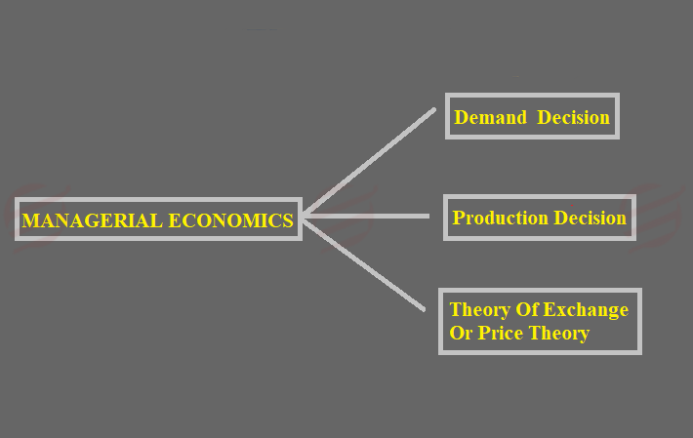

Slide 53
7. Basic tools in Managerial Economics
1. Opportunity cost
2. Law of Demand and Supply
3. Elasticity of Demand
4. Discounting principle
5. Equi-marginal principle
6. Break even Analysis
7. Demand forecasting
8. Law of Marginal Diminishing Utility

Slide 54
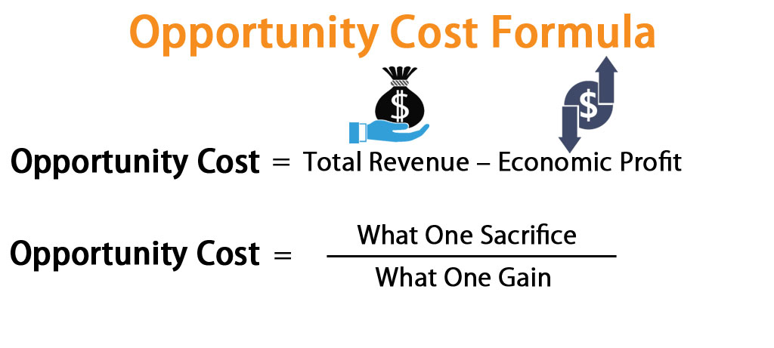
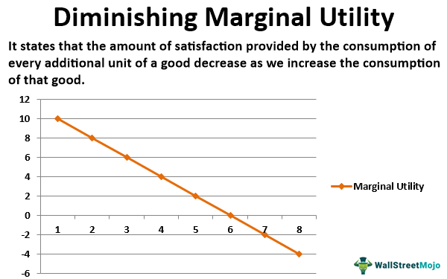

Slide 55
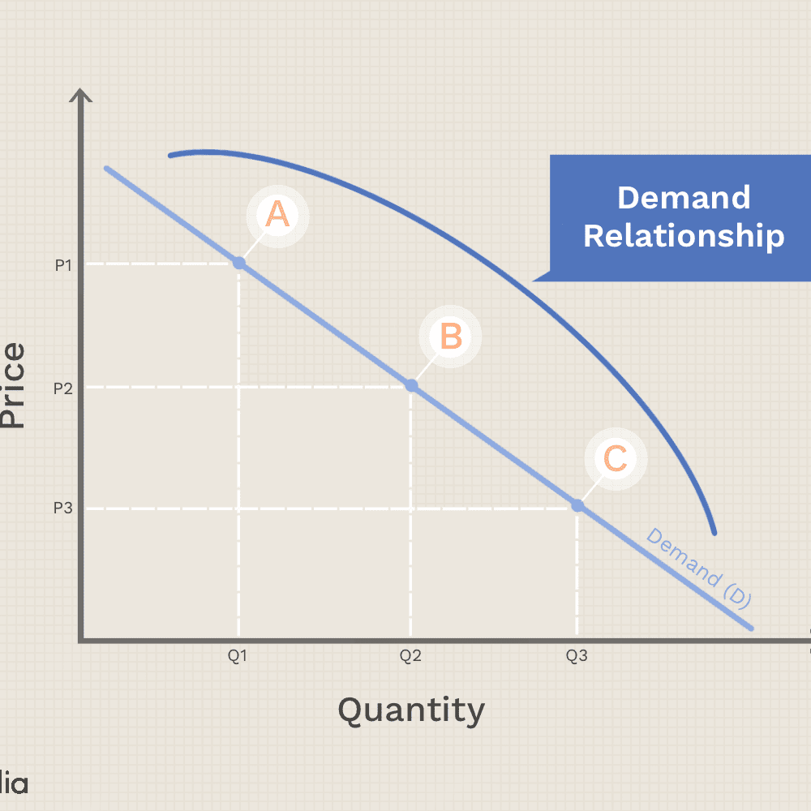
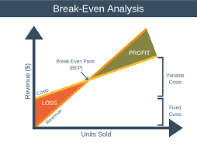
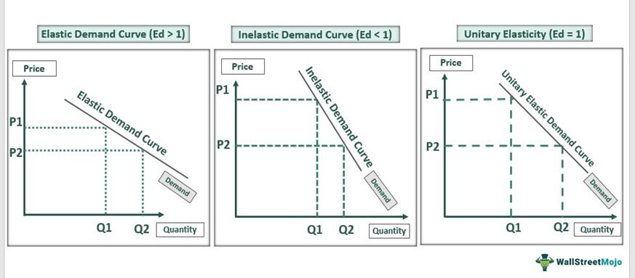

Slide 56



